Slide 1

SOCIAL NETWORK FRIEND RECOMMENDATION
Using Warshall’s Algorithm and Transitive Closure
Presented by:
Ahemad Patwe Roll No. 108
Alfiya Patel Roll No.109
Mangesh Gofane Roll No.110
Dnyaneshwar Rode Roll No.107
Under the guidance of Prof Sanjay gunjal Sir

Slide 2
PROBLEM STATEMENT
Social Network Friend Recommendation
This project represents users as nodes and their friendships as directed edges. Using Warshall’s Algorithm, the system calculates the transitive closure to find indirect connections, helping recommend:
Mutual friends (friends-of-friends).
Isolated users with fewer connections.
Communities or clusters of users in the network.

Slide 3
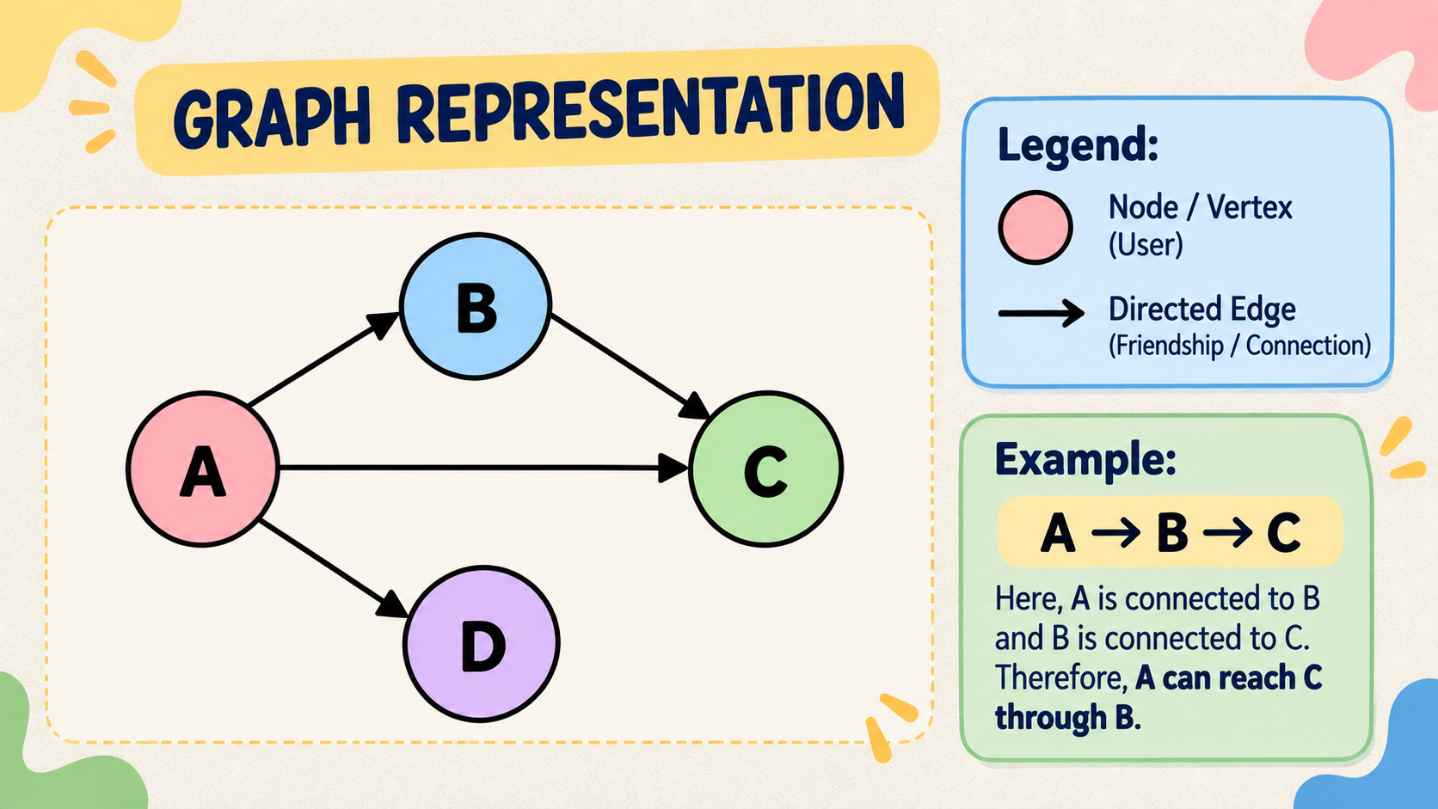
graph representation
A social network can be represented using a directed graph.
Nodes / Vertices → Users
Directed Edges → Friendships or connections
An arrow shows the direction of a connection.
Example:
A → B → C
Here, A is connected to B and B is connected to C.
Therefore, A can reach C through B.

Slide 4
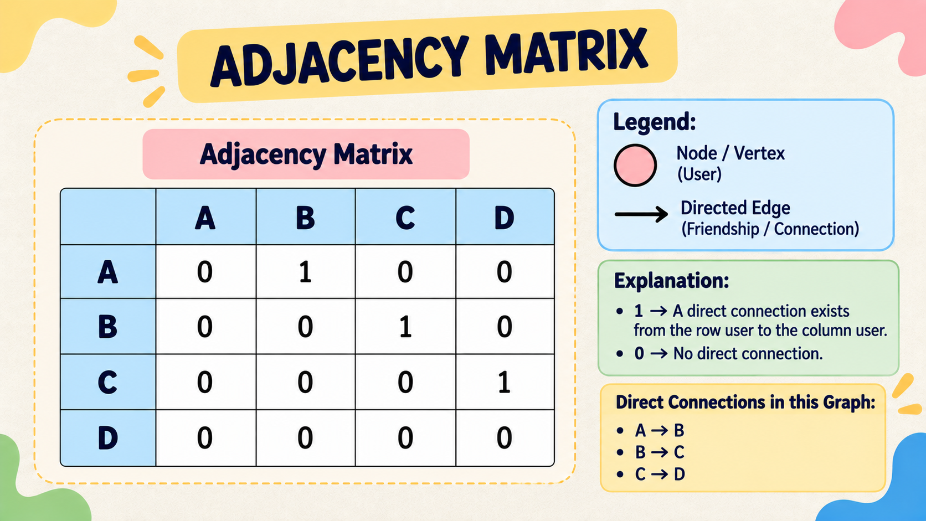
An adjacency matrix represents the connections between users using 0s and 1s.
The matrix provides the starting point for calculating the transitive closure.

Slide 5
TRANSITIVE CLOSURE
Transitive closure determines whether a user can reach another user directly or indirectly.
Example:
A → B
B → C
Therefore:
A → C
Although A does not have a direct connection with C, A can reach C through B.
Purpose:
To find all reachable connections in the network.

Slide 6
warshall`s Algorithm
Warshall’s Algorithm is used to calculate the transitive closure of a directed graph.
Formula:
R[i][j] = R[i][j] OR (R[i][k] AND R[k][j])
Where:
i = Starting user
j = Destination user
k = Intermediate user
Basic Idea:
If user i can reach user k, and user k can reach user j, then user i can reach user j.

Slide 7
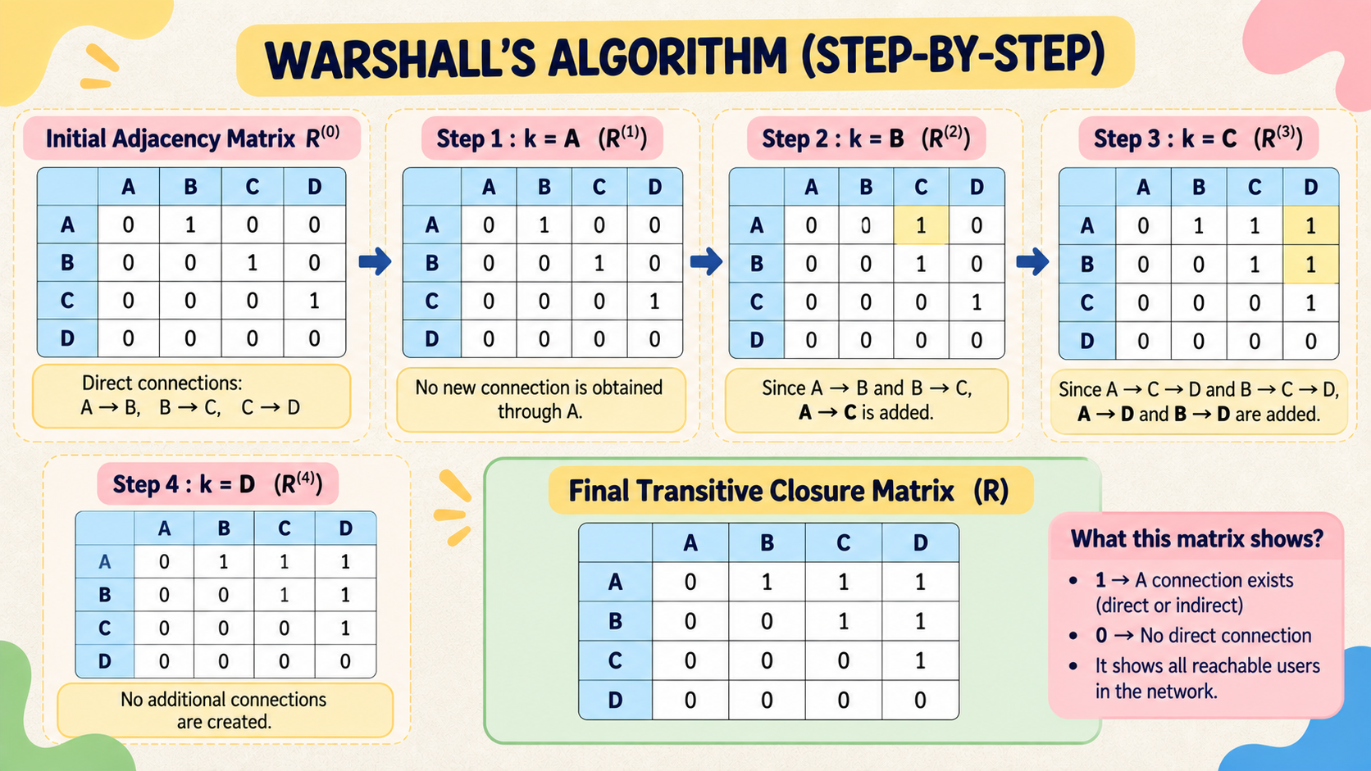

Slide 8
Friend recommendation
The transitive closure can be used to provide useful information about the social network.
Mutual Friends
Find friends-of-friends.
Recommend potential connections.
Isolated Users
Identify users with very few or no connections.
Communities
Identify groups or clusters of connected users.
Example:
A → B → C
Recommendation:
C may be recommended to A.

Slide 9


Slide 10


Slide 11
Final result and analysis :
From the transitive closure matrix:
Direct Connections
A → B
B → C
C → D
Indirect Connections
A → C through B
A → D through B and C
B → D through C
Friend Recommendations
A → C → C can be recommended to A.
B → D → D can be recommended to B.
A → D → D is an indirect connection of A.
chain/community:
A → B → C → D
Network Analysis
A has the highest reachability.
D has no outgoing connections and can be considered a terminal/low-connectivity user.
The users form one connected

Slide 12
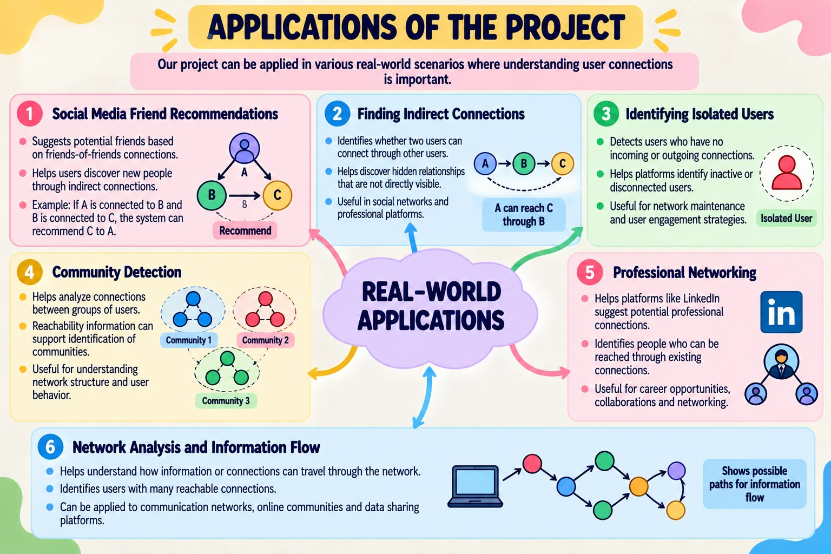

Slide 13
Conclusion:
Warshall's Algorithm successfully identifies both direct and indirect connections, allowing the system to generate friend recommendations and analyze the structure of the social network.

Slide 14
Thank You

